Slide 1
263F Project Mid Term
Shixuan Sun, Xiaoyang Zhao
Notes:
Quick self intro

Slide 2
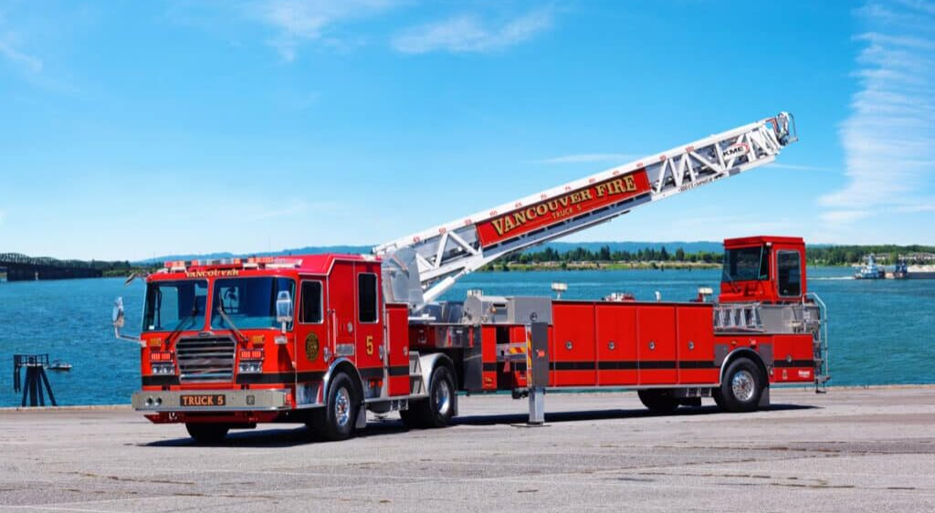
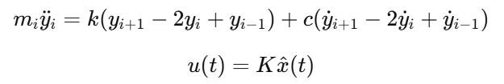
Active Oscillation Damping of a Fire-Rescue Turntable Ladder
Problem & Motivation
Flexible aerial ladders suffer from excessive vibration under wind loads.
Existing studies (Horváth 2020; Kharitonov 2007) focus on theoretical or high-cost control.
Objective: develop a simplified semi-active damping model using limited feedback.
Method Overview
External Wind Load f(t)
Flexible Ladder (spring–mass model)
Implicit Euler Integration
x(t+Δt) = x(t) + Δt·ẋ(t+Δt)
Reduced Tip Oscillation
(Returns to ~0 in 10 s)
Active Feedback Control
State Measurement
Notes:
Our project focuses on stabilizing fire-rescue turntable ladders, which can experience large vibrations under wind loads, especially when fully extended.
To address this, we model the ladder as a discrete spring–mass structure and simulate wind disturbances as external time-varying forces. Because the system is stiff, we use implicit Euler for stable time integration.
On top of the mechanical model, we implement a semi-active damping law: the controller measures displacement and angular velocity, then adjusts the torsional damping coefficient in real time to counteract oscillations.”

Slide 3
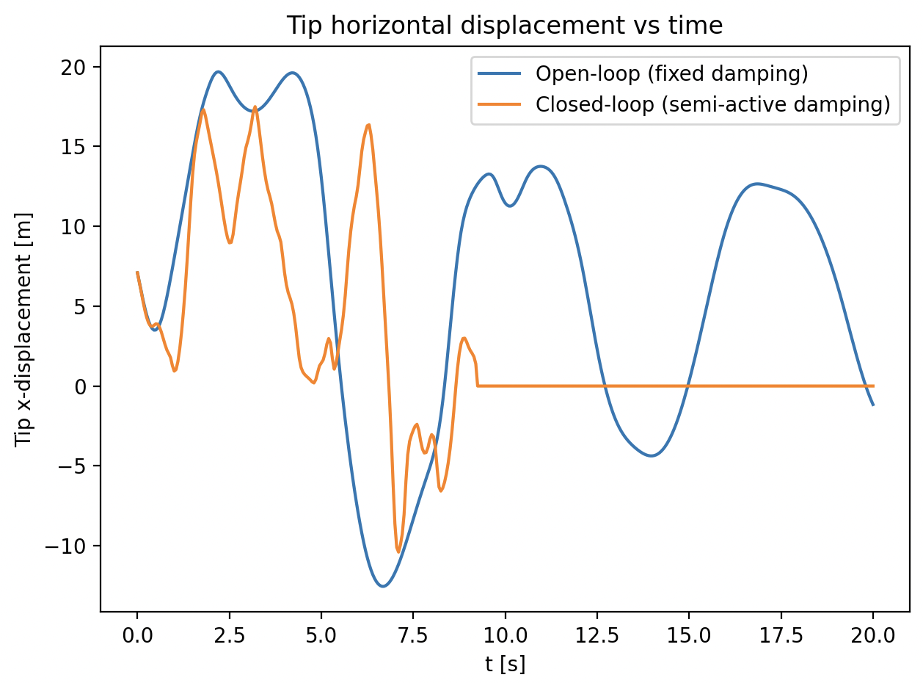
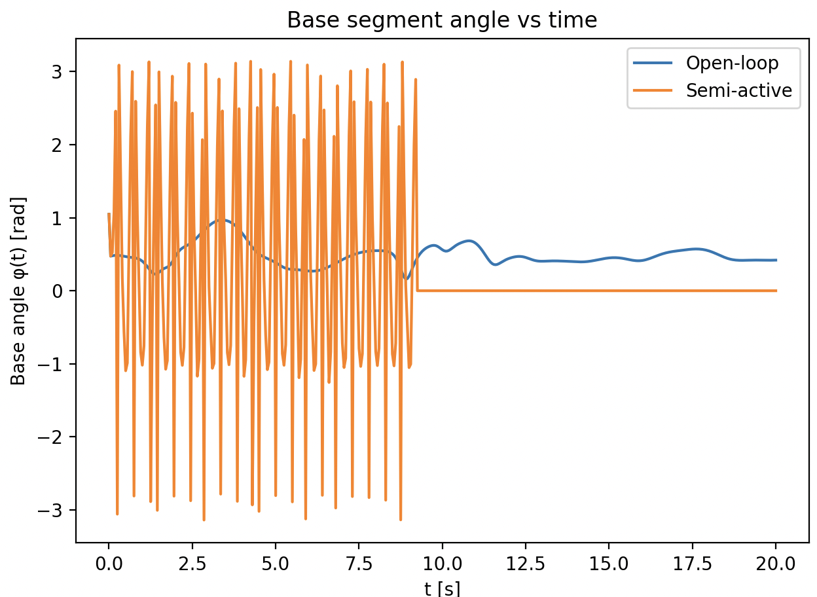
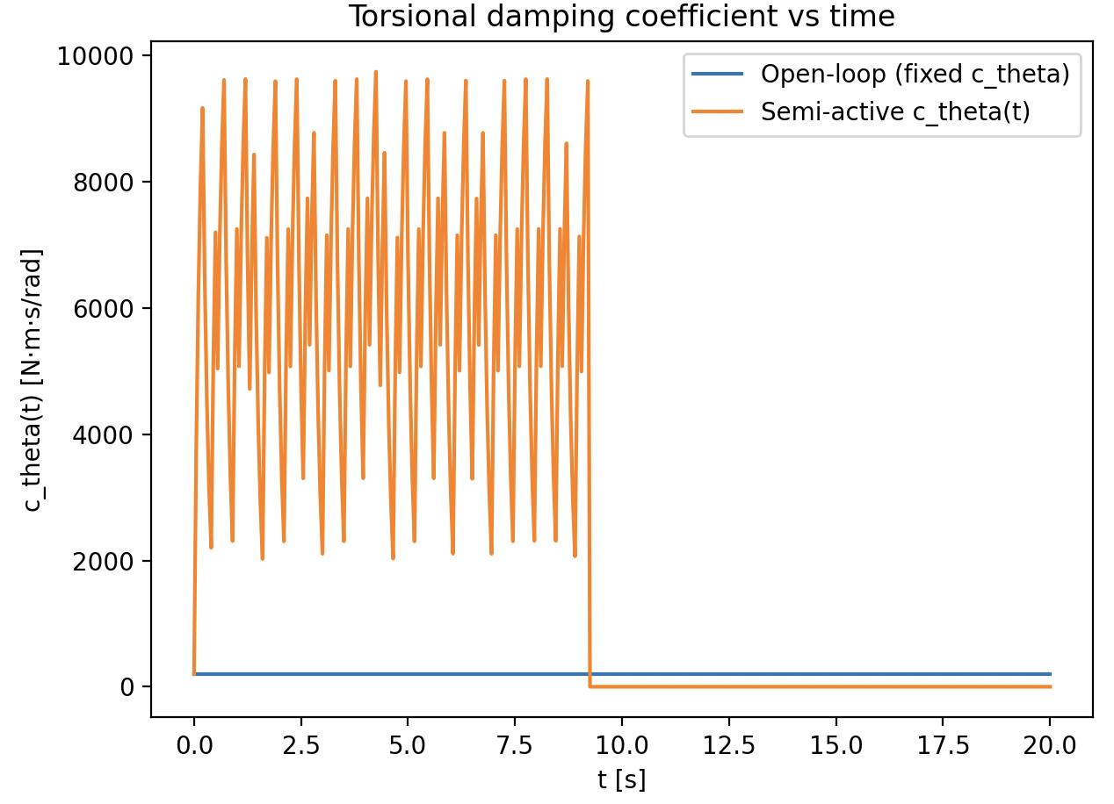
Preliminary Results
Next Steps:
Extend model to include vertical deflection and realistic wind load profiles.
Perform parameter sweep to optimize feedback gain K.
Quantitatively compare energy dissipation and settling time.
Prepare final visualization and report (≤ 5 pages).
Notes:
“Here are our preliminary results.
“The plot on the left shows the horizontal tip displacement. The open-loop system experiences very large oscillations, while the semi-active control quickly brings the displacement back toward zero.”
“The middle figure shows the base angle over time. Again, the closed-loop system converges much faster compared to the uncontrolled case.”
“Finally, the plot on the right shows the adaptive torsional damping coefficient. You can see that the controller increases or decreases damping in response to ladder motion, which is the source of the oscillation suppression.”
Next, we plan to extend the model to vertical motion, tune the feedback gain, and evaluate settling time and energy dissipation.

